Slide 1

Background
Removal Tool

Slide 2

Agenda
3 | Summary
4 | Technology Used
5 | Working
6 | Demo
7 | Conclusion

Slide 3

Summary
Innovative Background Removal Tool: Introduces a revolutionary approach to image editing, leveraging advanced segmentation technology for precise background removal.
Seamless User Experience: Offers an intuitive interface for effortless background removal, empowering users to edit images with ease and efficiency.
Future-Ready Capabilities: Continuously evolving with ongoing research and development, the tool is poised to deliver even greater accuracy, speed, and versatility in image editing workflows.
Back to Agenda

Slide 4

Technologies Used
AI Background Modifier | Python, Java, Django, React, MySQL, Android
Developed a full-stack web application which modifies background of images and videos.
Improved the speed of removal of background in videos with caching techniques and contour detection.
Users can change the background of their file with custom background.
Integrated U2-Net Model into Django Application and setup secure API’s to communicate with frontend.
The frontend is developed with react for web and native android for mobile and deployed on render.
Back to Agenda

Slide 5
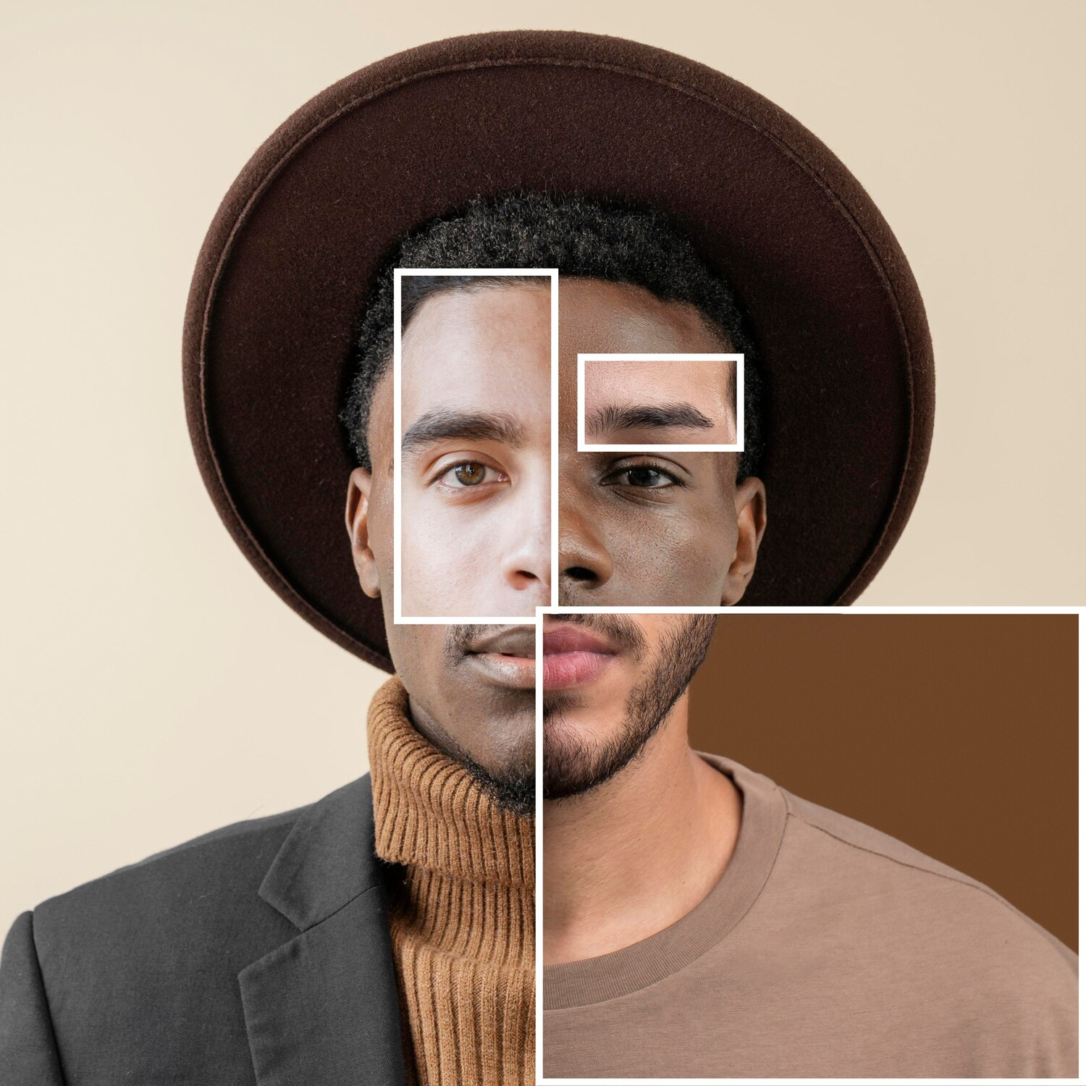
Working
Simply Login to the website
Upload your desired Image/ video.
Click on Remove
That’s it !!!
Now download your background removed file.
Back to Agenda

Slide 6
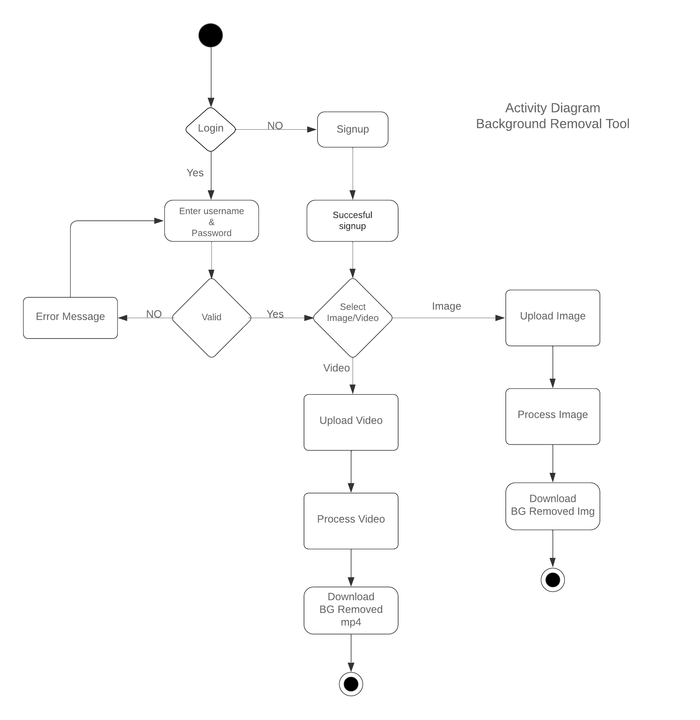
Activity Diagram

Slide 7
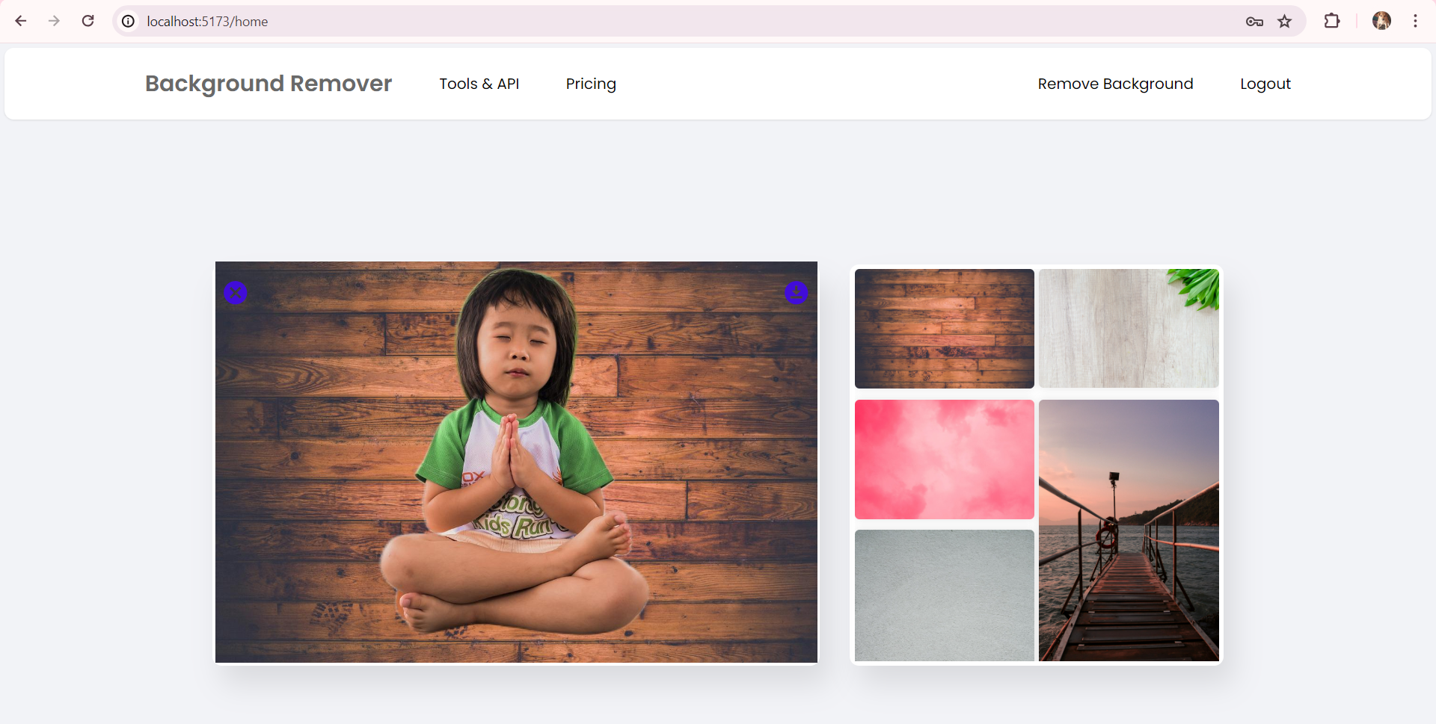
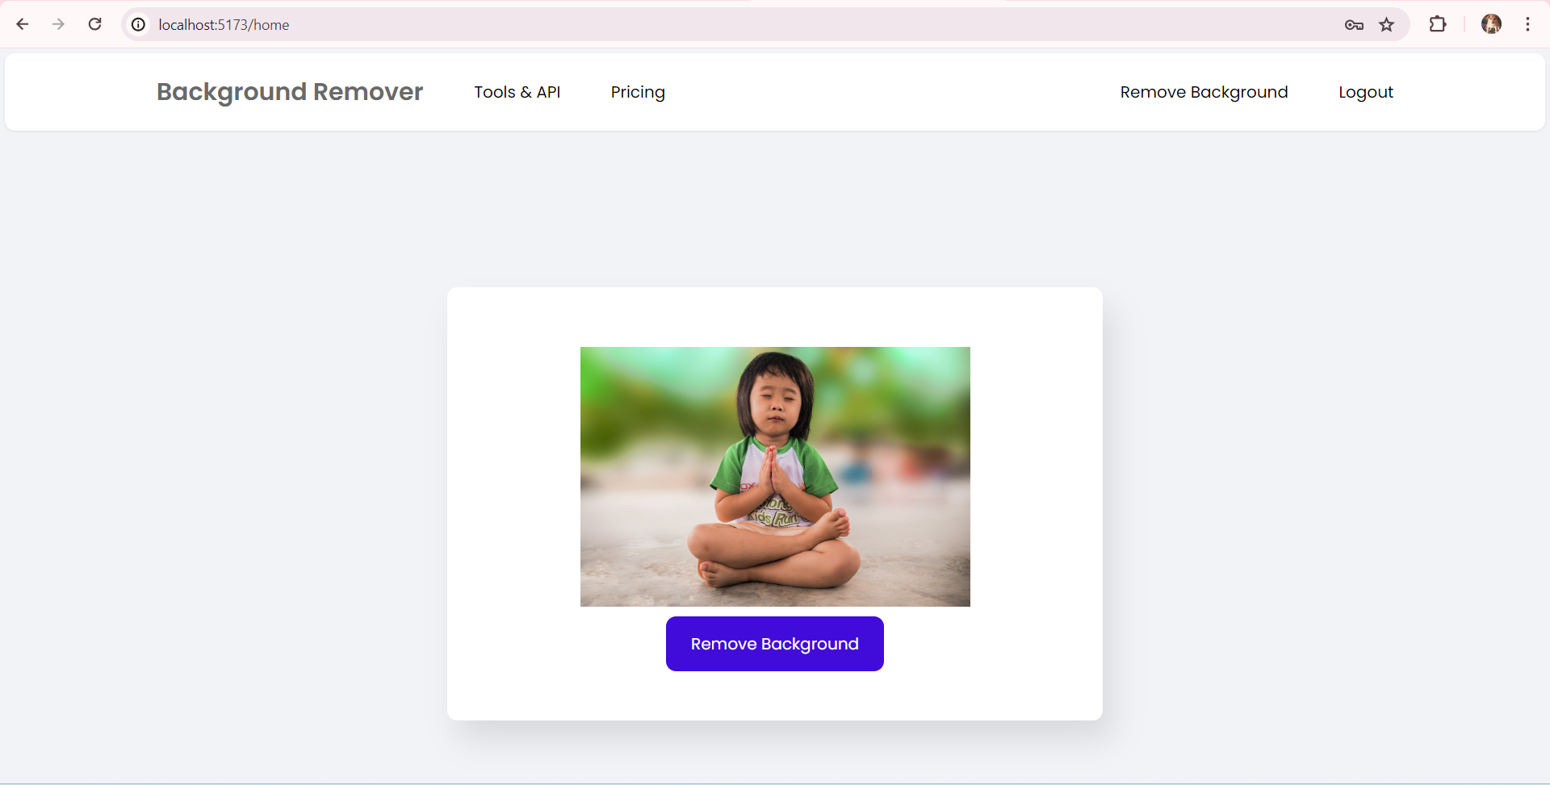
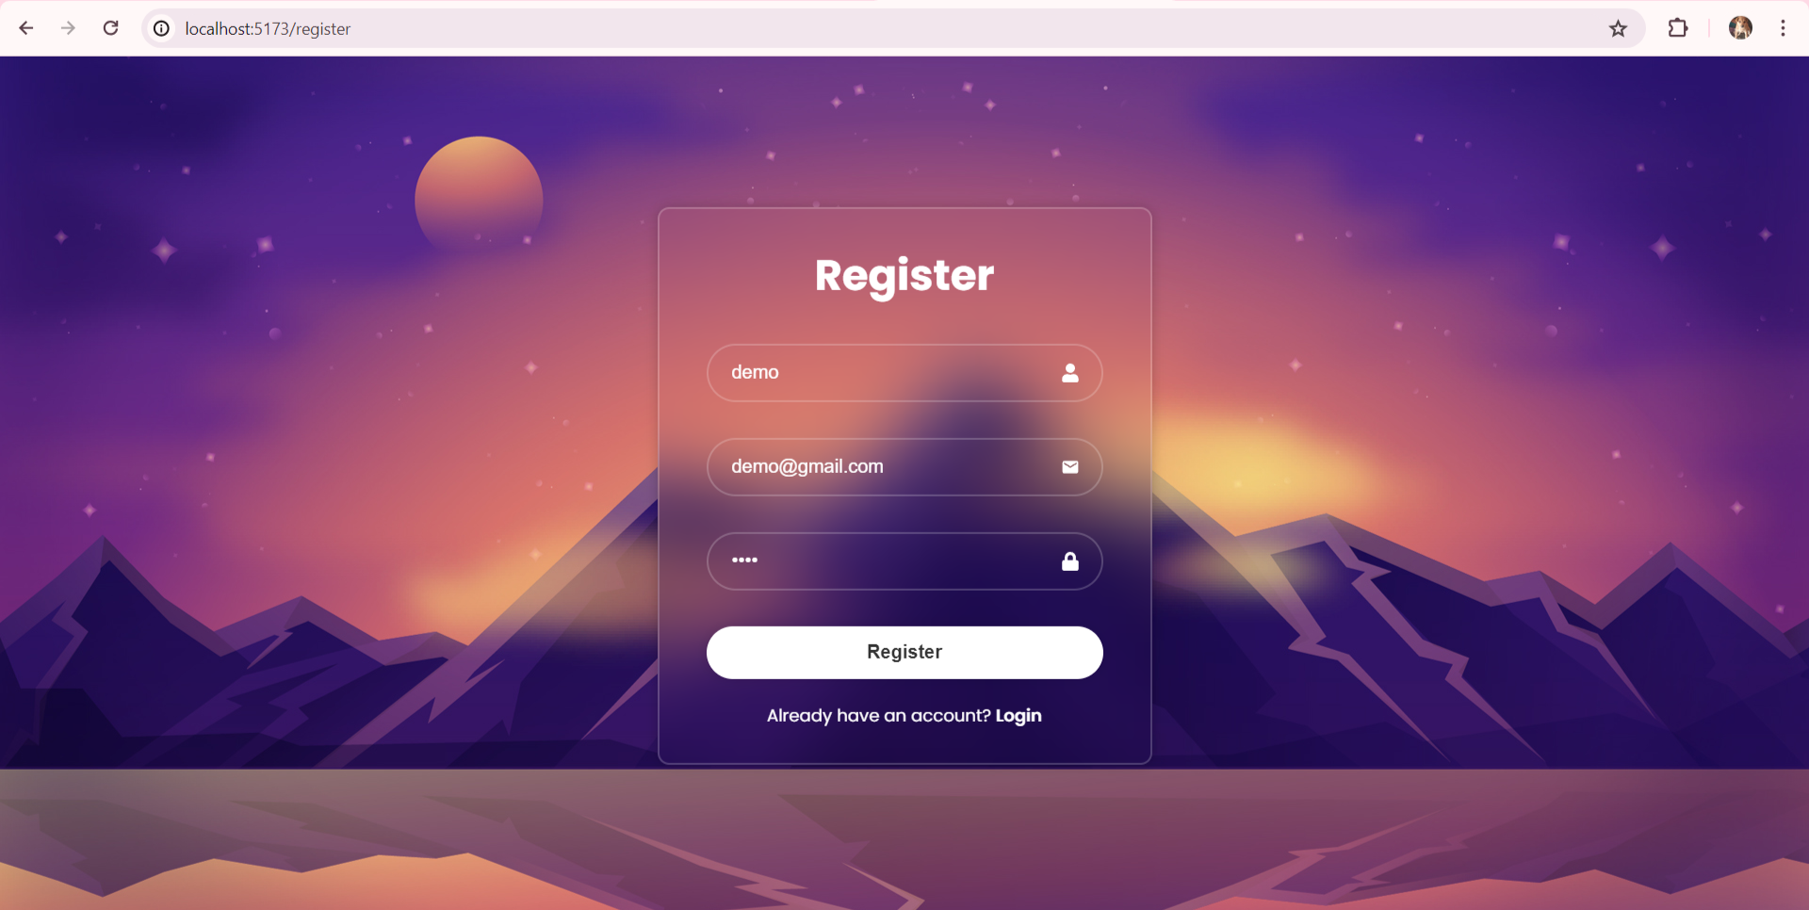
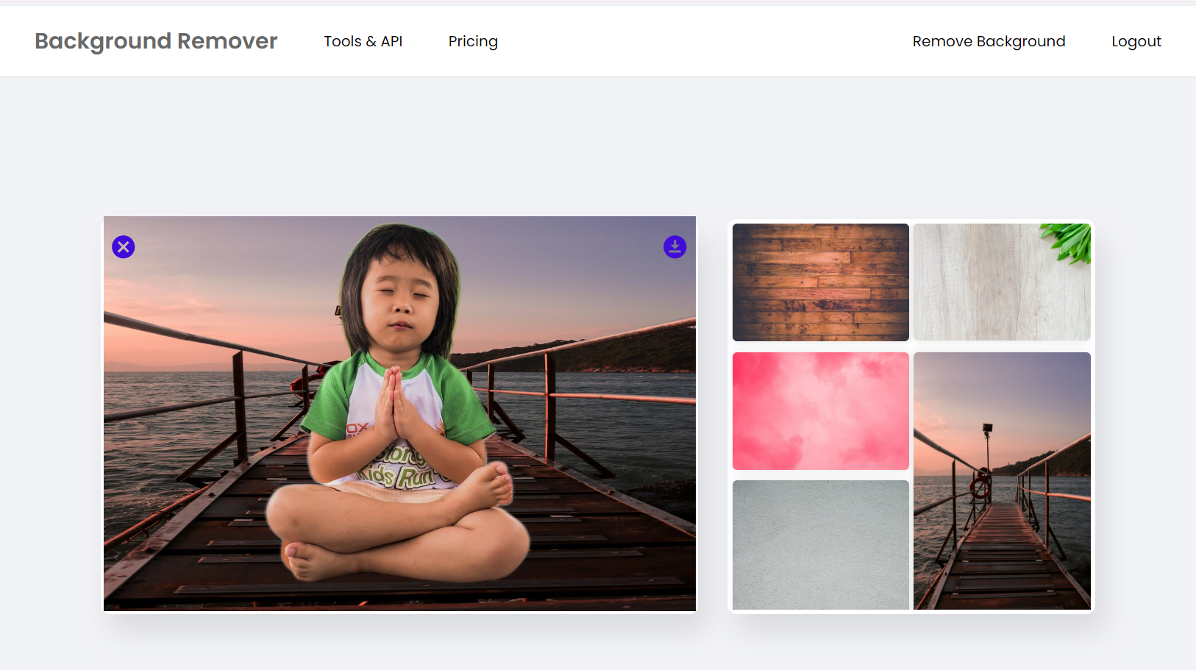
Demo
Drag and drop your photo or video! Click the sample photo or video and delete. Select yours from the uploads tab, drag, and then drop inside the frame!

Slide 8
Conclusion
Revolutionary Technology: Our background removal tool represents a significant advancement in image editing, offering unparalleled accuracy and efficiency through cutting-edge segmentation algorithms.
Enhanced User Experience: With a user-friendly interface and seamless functionality, the tool empowers users to effortlessly edit images and create stunning visual content.
Continuous Innovation: Committed to ongoing research and development, we strive to push the boundaries of image editing technology, ensuring that our tool remains at the forefront of innovation in the field.
Empowering Creativity: Whether for professionals or enthusiasts, our background removal tool unlocks new possibilities for creative expression, enabling users to bring their vision to life with precision and ease.

